Slide 1
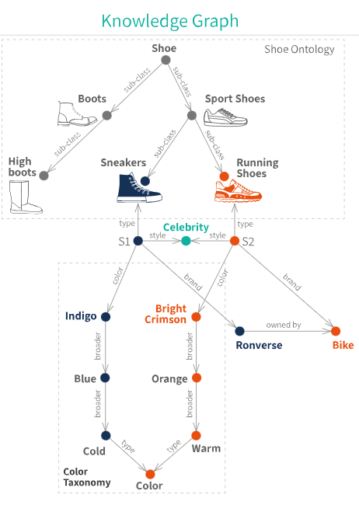
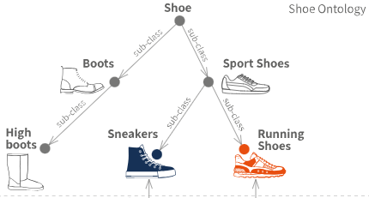
Knowledge Graph
Structured representation of information, where data is organized in the form of a graph
Consisting of
Nodes (entities or concepts) and
Edges (relationships or associations between nodes)
Designed to model, store, and organize complex information in a way that makes it easy for both humans and machines to understand, navigate, and use the knowledge it contains.

Slide 2
Example of Knowledge Graph for Hospital
Nodes Patient, Doctor, Medication, Treatment, Diagnosis
Edges
"Diagnosed with" (connecting Patient and Diagnosis),
"Prescribed" (connecting Doctor and Medication),
"Treated with" (connecting Patient and Treatment)
Entity Example: people, locations, organizations etc. (basically Nodes)
Diagnosed with
Patient
Disease
Treated by
Doctor
Treated with
Treatment
Prescribed
Medication

Slide 3
https://microsoft.github.io/graphrag/
GraphRAG
Graph-based Retrieval-Augmented Generation
Leverages knowledge graphs to enhance the capabilities of LLMs
Extracts structured data from unstructured text and organizes it into a knowledge graph
More Accurate and Contextually relevant answers – by connecting different pieces of Info.
Imagine an LLM looking at a graphical representation of a data – it will have a clear understanding of connectivity between information and therefore can answer more logically
Hence GraphRAG helps an LLM connect the dots
Step-by-Step Example of GraphRAG
Data Collection
Entity Extraction
Knowledge Graph Creation
Query Processing
Answer Generation

Slide 4
GraphRAG Examples
Contracts: Using GraphRAG, you can create a knowledge graph that maps entities like companies, individuals, dates, and legal terms from contract documents. The graph can help in quickly querying specific terms, identifying patterns, and suggesting amendments.
Procurement: Build a knowledge graph connecting suppliers, products, prices, and contract terms. GraphRAG can help identify the most reliable and cost-effective suppliers based on historical data and performance metrics.
Supply Chain Management: Create a knowledge graph mapping out suppliers, logistics, inventory levels, and sales data. Use GraphRAG to predict potential supply chain disruptions and suggest alternative routes or suppliers.
Engineering Document Comparison: Build a knowledge graph that captures the relationships between different components, materials, and specifications. Use GraphRAG to highlight changes and suggest optimizations based on historical data and best practices.
Table Information Extraction from Brochures: Extract tables from brochures, create a knowledge graph with the extracted data, and use GraphRAG to query specific information, like product specifications or pricing.

